Slide 1
Dynamic Optimization and Reinforcement Learning Exam
Solution by Lucas Stampe and Kevin Wesendrup

Slide 2
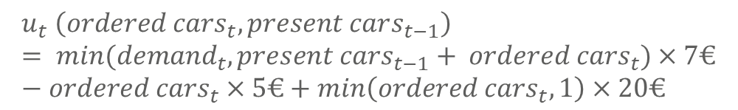
Exercise 1a
Contemporaneous Profit of a Business Day
Task: Write down the contemporaneous profit of a business day as a function of the number of cars that you order and the number of cars present on the previous evening. Hint: To simplify the time structure of the problem, it helps to pretend that you decide about the order in the morning and the cars are then delivered immediately.
Answer:
$$u_{t} \left({ordered cars}_{t}, present cars_{t−1}\right)= {min(demand}_{t},{present cars}_{t−1}+ {ordered cars}_{t})×7€−{ordered cars}_{t}×5€+\min\left({ordered cars}_{t}, 1\right)×20€$$

Slide 3
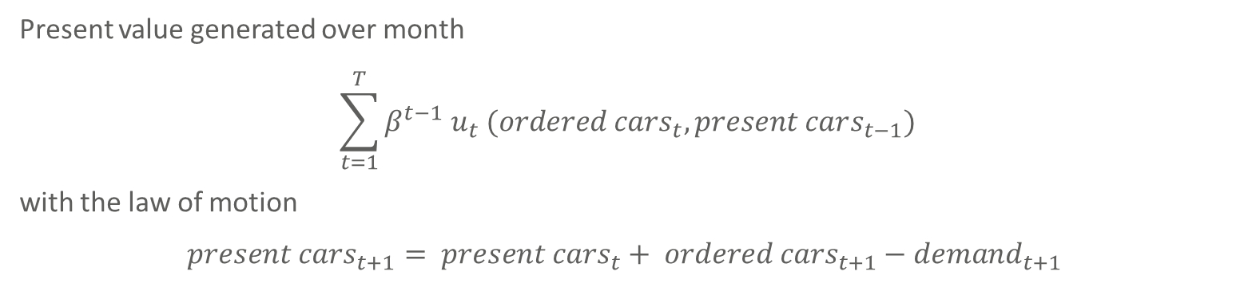
Exercise 1b
Value and Law of Motion
Task: Write down the present value of the profit that you generate over the month. Also write down the associated Bellman equation. What is the state and the control of this problem. What is the tradeoff that you face?
Answer:
Present value generated over month
$$\sum_{t=1}^{T}{β^{t−1} u_{t} ({ordered cars}_{t}, present cars_{t−1})}$$
with the law of motion
$${present cars}_{t+1}= {present cars}_{t}+ {ordered cars}_{t+1}−{demand}_{t+1}$$

Slide 4
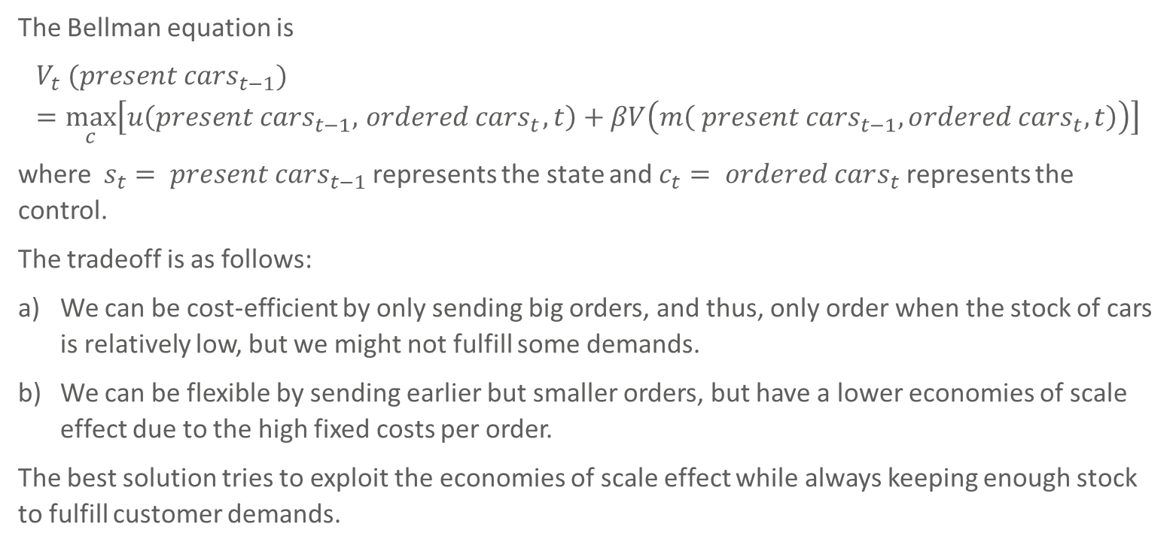
Exercise 1b (cont’d)
Bellmann Equation and Tradeoff
The Bellman equation is
$$V_{t} ({present cars}_{t−1})=\max_{c}\left[u\left({present cars}_{t−1},{ ordered cars}_{t}, t\right)+βV\left(m\left({ present cars}_{t−1}, o{rdered cars}_{t},t\right)\right)\right]$$
where $s_{t}= {present cars}_{t−1}$ represents the state and $c_{t}= ordered cars_{t}$ represents the control.
The tradeoff is as follows:
We can be cost-efficient by only sending big orders, and thus, only order when the stock of cars is relatively low, but we might not fulfill some demands.
We can be flexible by sending earlier but smaller orders, but have a lower economies of scale effect due to the high fixed costs per order.
The best solution tries to exploit the economies of scale effect while always keeping enough stock to fulfill customer demands.

Slide 5
Exercise 1c
Value Function
Task: The value function is represented by a matrix of dimension 30 x 26. Suppose row 5 of the matrix looks like this (these values are not the true value function):
[5 7 11 16 22 27 28 29 … 85 90]
Explain the meaning of these matrix entries.
Answer: With 30 rows, one for each of the 30 days, the 5th row indicates the values of having a certain number of cars for day 5. Under the assumption that the first item means that 0 cars are present, every subsequent position indicates how many cars are supposed to be present to maximize the profit for the day up until 25. The numbers indicate how high any of those states are valued, and having a full stock seems to be the most valuable option for day 5 with a value of 90.

Slide 6
Exercise 1d
Solving the Problem
Task: Solve numerically for the value function. Derive the optimal ordering path for t = 1, …, 30. Plot the optimal path. Calculate the total profit in the month. Analyse how this changes if the service fee per order is drastically decreased to 1€.
Answer: See R Script „Exam_Exercise_1.R“. The total profit is 738€.

Slide 7
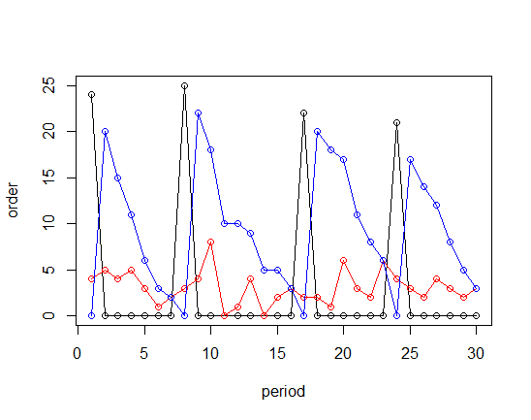
Exercise 1d (cont’d)
The Result
In the following plots, the red line represents the demand, the blue line the stored cars at any given moment and the black line the number of ordered cars
The total profit is 83.
An order does not always fill up to the maximum stock, but tries to postpone “investments” due to the discount factor beta.
The solution takes ad-vantage of big lot sizes.
An order is only sent when the stock reaches zero.

Slide 8
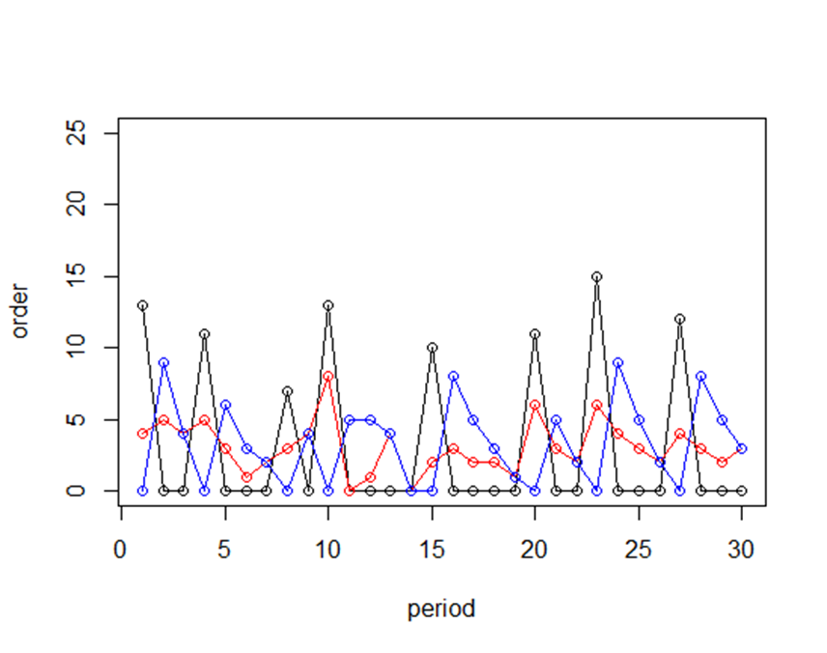
Exercise 1d (cont’d)
Reducing the Fixed Costs
If we drastically change the fixed costs per order to 1€, the ordered amount will be closer to the demand as the economic lot size for one order is smaller.
The total profit is 155.

Slide 9
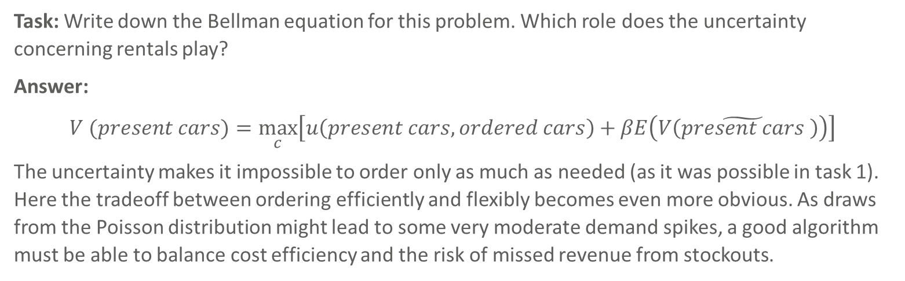
Exercise 2a
Stochastic Optimization
Task: Write down the Bellman equation for this problem. Which role does the uncertainty concerning rentals play?
Answer:
$$V (present cars)=\max_{c}\left[u\left(present cars, ordered cars\right)+βE\left(V\left(\tilde{present cars} \right)\right)\right]$$
The uncertainty makes it impossible to order only as much as needed (as it was possible in task 1). Here the tradeoff between ordering efficiently and flexibly becomes even more obvious. As draws from the Poisson distribution might lead to some very moderate demand spikes, a good algorithm must be able to balance cost efficiency and the risk of missed revenue from stockouts.

Slide 10
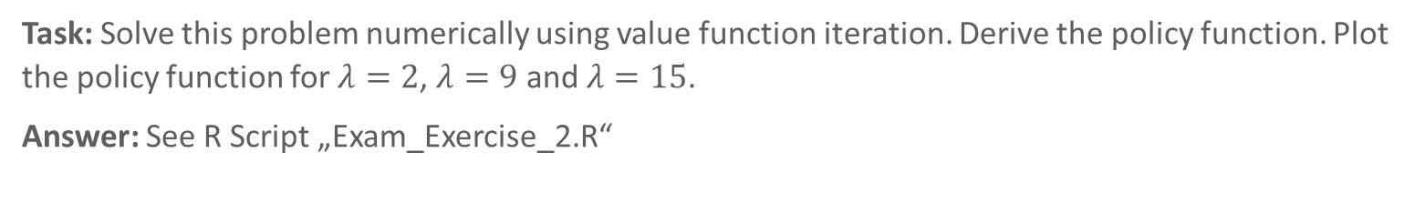
Exercise 2b
Solving the Problem
Task: Solve this problem numerically using value function iteration. Derive the policy function. Plot the policy function for $λ=2$, $λ=9$ and $λ=15$.
Answer: See R Script „Exam_Exercise_2.R“

Slide 11
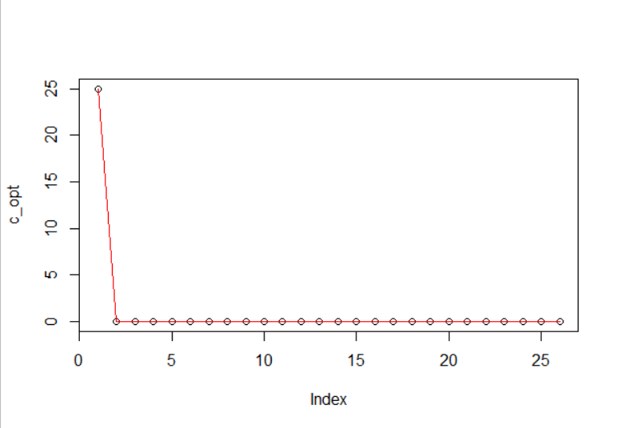
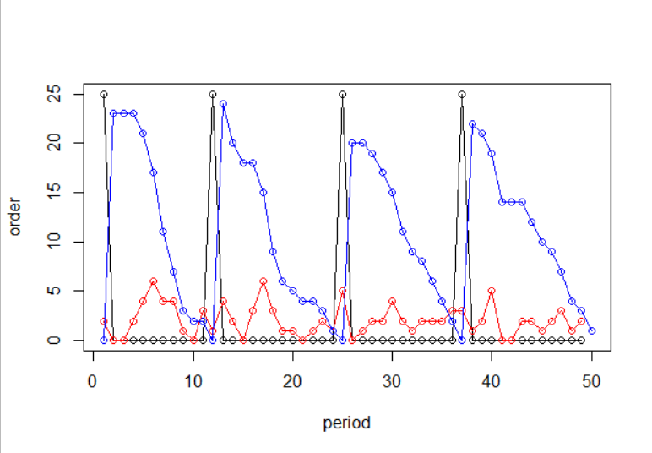
Exercise 2b (cont’d)
Lambda = 2
Policy function. X-axis is state (present cars). Y-axis is the optimal order policy.
Simulation for tt = 1:50
Only order at stock = 0. Always order 25 cars.
This might lead to stockouts!

Slide 12
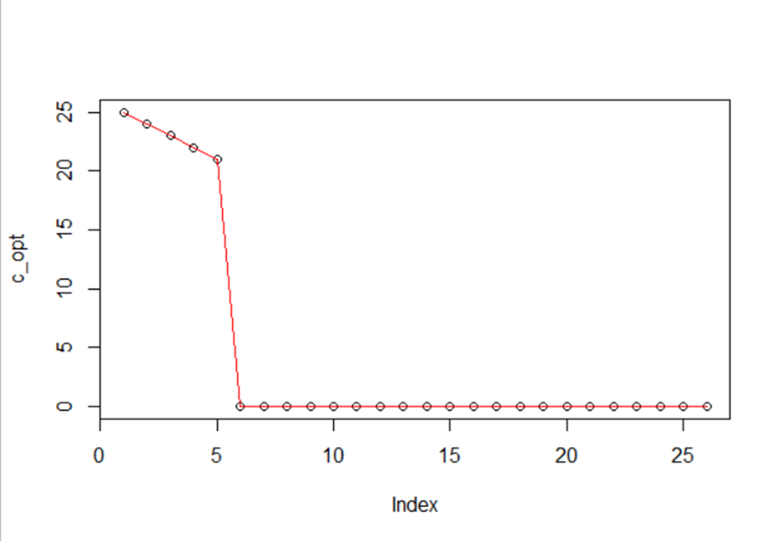
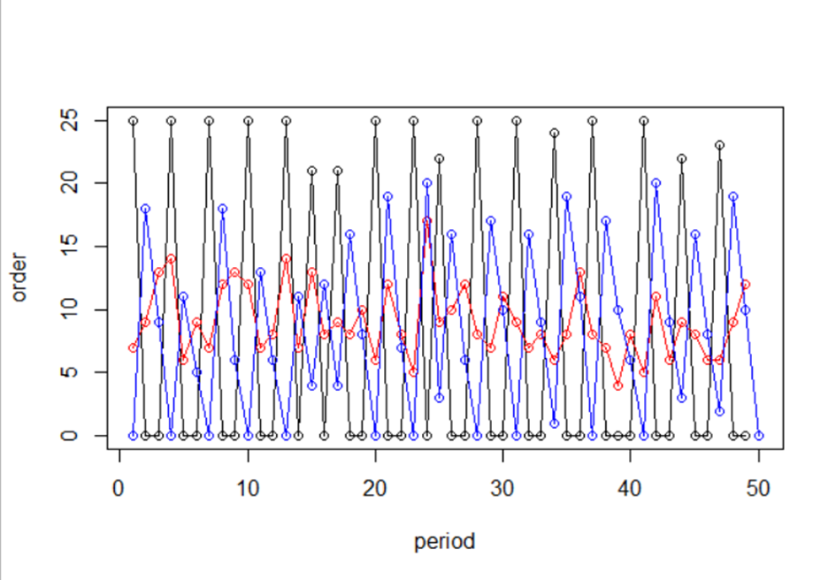
Exercise 2b (cont’d)
Lambda = 9
Policy function. X-axis is state (present cars). Y-axis is the optimal order policy.
Simulation for tt = 1:50
Order at stock = [0, 5]. Always max out stock.

Slide 13
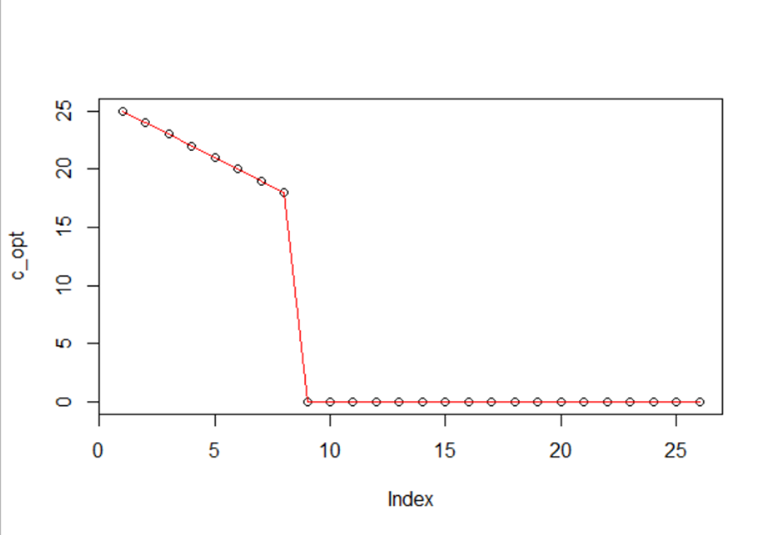
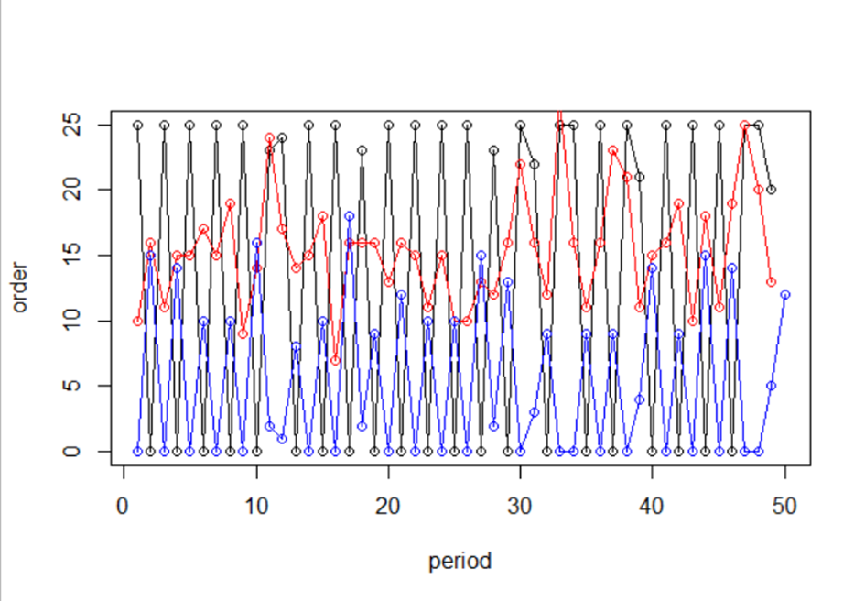
Exercise 2b (cont’d)
Lambda = 15
Policy function. X-axis is state (present cars). Y-axis is the optimal order policy.
Simulation for tt = 1:50
Order at stock = [0, 8]. Always max out stock.

Slide 14
Exercise 3a
Action Value Net
Task: Use the load() command to load janestate.RData into R; it should look like this:
Now, have a look at janestate, it shows all demand side states. Which supply side state would you need to add in order to achieve the complete set of states? How many input neurons do you need to represent the action value function?
Answer: We still require the current number of available cars since with that, we can calculate the profit per rented car and costs per remaining car. This means we have 7 (weather) + 7 (rental requests) +1 (day of the week) + 1 (available cars) = 16 input neurons (apart from bias). If we create the net for the Action-Value-Function, we still need one input more for the action for a total of 17.

Slide 15

Exercise 3b
Creating the Net
Task: Create an artificial neural network with an input layer of size according to (a), a single hidden layer of 50 swish neurons and a linear output layer.
Answer: See R scripts “Exam_Exercise_3.R”, “Exam_Exercise_3_NN.R”.

Slide 16
Exercise 3c
Creating the Net
Task: Janes car rental itself is obviously non episodic, but since we only have data for three years, we just work as if it was an episodic task, i.e. after we reach the end of the data set, we start another epoch of learning, beginning with the first day. We always start an epoch at the evening of day one with no cars in stock and decide to order no car for the next day. Use on policy SARSA to let your ANN learn the action value function.
Store the rewards of all iterations of an epoch and compute the average rewards over each epoch. Store the ANN with the highest average reward over an epoch.
Answer: See R scripts “Exam_Exercise_3.R”, “Exam_Exercise_3_NN.R” and neural network “our_net.rds”

Slide 17
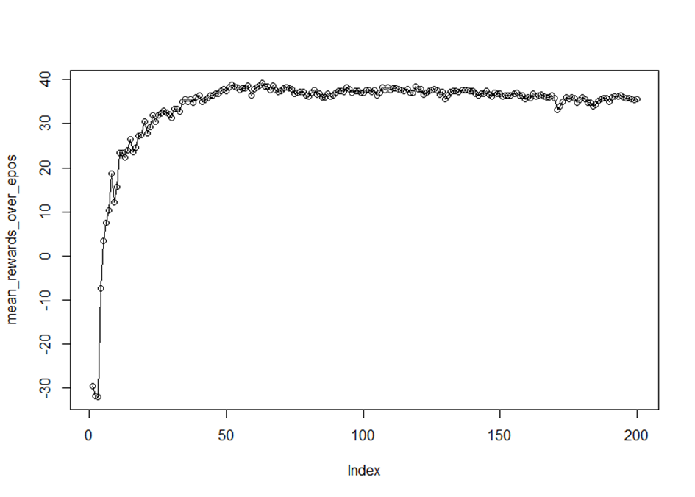
Exercise 3c (cont’d)
Plotting the Learning Curve
The algorithm converges at around a reward of ~39€ and finds its best solution at epoch 63 (reward = 39.20€)
On the x-axis, the epochs are shown. On the y-axis the average rewards per epoch are depicted.

Slide 18
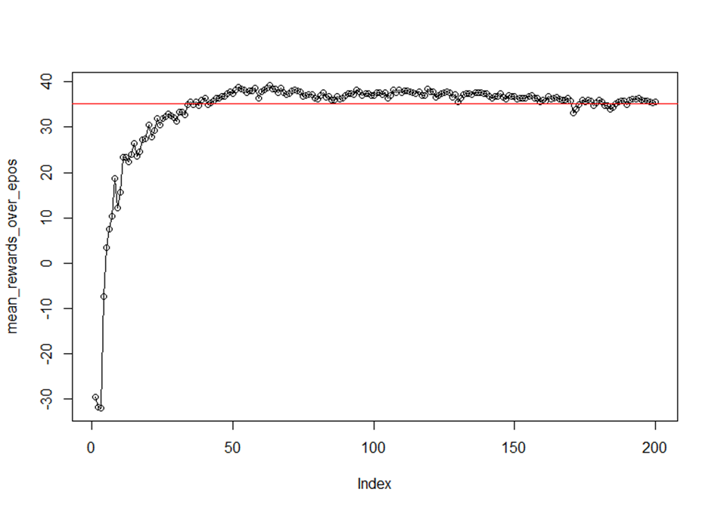
Exercise 3d
Reinforcement Algorithm vs. Simple Heuristic
Task: Compare the average reward using the ANN to this simple rule of thumb: "Request cars until the number of cars tomorrow morning equals the number of rentals, today“
Answer: See R scripts “Exam_Exercise_3.R”, “Exam_Exercise_3_NN.R” and neural network “our_net.rds”
The simple rule of thumb can achieve an average reward of 35.26€ (red line). After a few iterations, the reinforcement algorithm can surpass the performance of the simple heuristic!

